Slide 1

Updation Maps of constructed roads Detected through Satellite Imagery
C SAI SANTOSH REDDY - 2010030033
D HARANATH - 2010030044

Slide 2
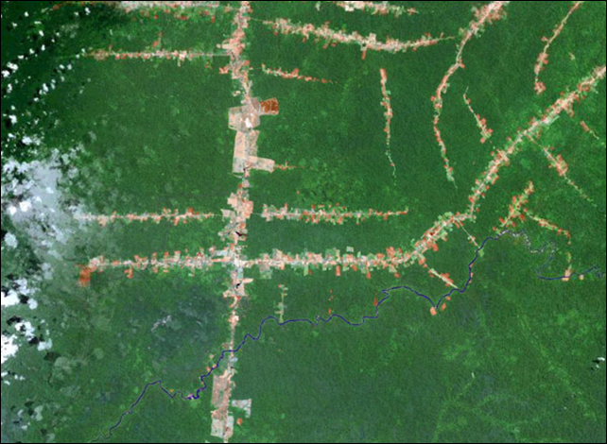
Introduction:
As Updating street maps of the constructed roads is the heavy process . Where many of the techniques have been proposed according to the automatic parts of Geographical data sources.
Where most of the techniques primary uses Gps(Global positioning system) in the Updating of the street maps.
To reduce this issue we use the satellite images and the geospatial data sources such as gps sources to reduce the cost of the maintaining digital maps .
we already have existing high quality maps that cover the vast majority of the world, these inferred road networks are not directly useful. Instead, an end-to-end map update system must process geospatial data sources to update and improve existing digital maps.

Slide 3


Problem statement
As we observe during the construction of the roads, The traffic increases as the road gets blocked by the road authority.
This problem could be even more difficult for the emergency services such as ambulances(Where person’s life is in danger due to traffic or far roadway).
Even the above problem is not been displayed on the most dependable feature know as the google maps. Which covers the major part of the world ,where these road networks fail during displaying of the constructed roads.

Slide 4
Techniques and methods used:
APPLIED COMPUTING
CARTOGRAPHY
We first consider extending current map extraction techniques for updating maps. We will show that these methods perform poorly on map update, creating many false positive updates.
Suppose there are two ways A, B from source destination to final destination:
A is largely human-curated it captures the roads, move accurately than B
B includes a walk way, mud way, tunnels that can’t be detected by the satellite.
We demonstrate the false mapping by State-of the art inference method

Slide 5
Cartography:
Its is the practice of making and using maps. Combining science, aesthetics and technique, cartography builds on the premise that reality (or an imagined reality) can be modeled in ways that communicate spatial information effectively.
The fundamental objectives of traditional cartography are to:
Set the map's agenda and select traits of the object to be mapped. This is the concern of map editing. Traits may be physical, such as roads or land masses, or may be abstract, such as toponyms or political boundaries.
Represent the terrain of the mapped object on flat media. This is the concern of map projections.
Eliminate characteristics of the mapped object that are not relevant to the map's purpose. This is the concern of generalization.
Reduce the complexity of the characteristics that will be mapped. This is also the concern of generalization.
Orchestrate the elements of the map to best convey its message to its audience. This is the concern of map design.

Slide 6
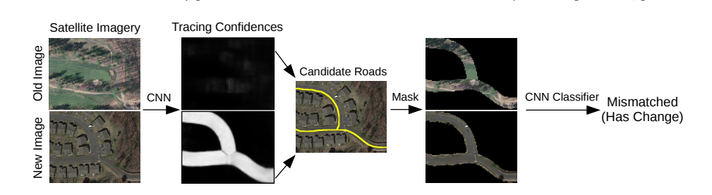
Deep leaning method
We use CNN for the comparison of the old and new image which can be used for the updation of the roads.

Slide 7
LITERATURE SURVEY:
SNO | TITLE | AUTHOR | CONCLUSION
1 | Updating Street Maps using Changes Detected in Satellite Imagery [2019-2020] | Favyen Bastani, Songtao He1 , Satvat Jagwani1 , Mohammad Alizadeh1 , Hari Balakrishnan | They found that existing state-of-the-art street map inference systems exhibit low precision when applied to update an existing map dataset, OpenStreetMap
2 | Simultaneous Extraction of Roads and Buildings in Remote Sensing Imagery with Convolutional Neural Networks. [2020] | Rasha Alshehhi, Prashanth Reddy Marpu, Wei Lee Woon, and Mauro Dalla Mura. | It is based on patch-based CNN, which consists of five convolution layers and replaces fully connected layers with GAP(Gaussian approximation potential). Low-level shape features of roads-regions (elongation and asymmetry) and building regions (compactness and density) are integrated with CNN features to connect disjointed road

Slide 8
SNO | TITLE | AUTHOR | CONCLUSION
3 | Automatic Extraction of Road Networks from Aerial Images. In CVPR. 2021 | Sanjay Chawla, Sam Madden, and David DeWitt | High-resolution aerial imagery provides a promising avenue to automatically infer a road network. Prior work uses convolutional neural networks (CNNs) to detect which pixels belong to a road (segmentation), and then uses complex post-processing heuristics to infer graph connectivity.

Slide 9
SNO | TITLE | AUTHOR | CONCLUSION
4 | Improved Road Connectivity by Joint Learning of Orientation and Segmentation. | Anil Batra, Suriya Singh, Guan Pang, Saikat Basu, CV Jawahar, and Manohar Paluri | They demonstrate the advantages of the approach on two diverse road extraction datasets SpaceNet and DeepGlobe. This approach improves over the state-of-the-art techniques by 9% and 7.5% in road topology metric on SpaceNet and DeepGlobe, respectively.

Slide 10
CONCLUSION:
We select an open-street map( It is made available as a base map for GIS work in ESRI(The leading mapping and spatial analytics software designed to support the mission and business objectives of organizations around the globe, regardless of size) products) and map them by relating too the year of construction on a scale.
We apply Maid (Mobile Ad id) to recover these removed roads and score its performance in terms of their precision, recall comparing the other routes

Slide 11
flowchart
CAPTURE SATELITE IMAGINERY
PRE
PROCESS
ING
IMAGE PROCESSING
VERFICATION
UPDATE MAPS

Slide 12
DESCRIPTION ABOUT FLOW CHART
1)Capture satellite imagery: First, satellite imagery of the area in question must be captured using a satellite or aerial platform. The imagery should have a high enough resolution to clearly identify road construction activity.
2)Pre-processing: The satellite imagery must be pre-processed to remove any distortions or artifacts that may affect the accuracy of the analysis. This may involve correcting for atmospheric effects, geometric distortions, and other factors that can impact the quality of the imagery.
3)Image analysis: The pre-processed imagery is then analyzed to identify road construction activity. This may involve using computer vision algorithms to detect changes in the landscape or identifying new features that may indicate road construction activity.
4)Verification: Once the imagery analysis is complete, the results must be verified for accuracy. This may involve comparing the satellite imagery to ground-based surveys or other sources of information to ensure that the construction activity has been correctly identified.
5)Update maps: Finally, the information about the road construction activity can be updated in maps or other geospatial databases to provide users with the most up-to-date information.

Slide 13
THANKYOU

